Slide 1
Cognitive services, the next step in creating our robot overlords
Harold Pulcher
pulcher@pulcher.biz
@haroldpulcher
https://www.youtube.com/user/hpulcher
https://github.com/pulcher/AzurePlay

Slide 2









































TITANIUM SPONSORS
Platinum Sponsors
Gold Sponsors

Slide 3
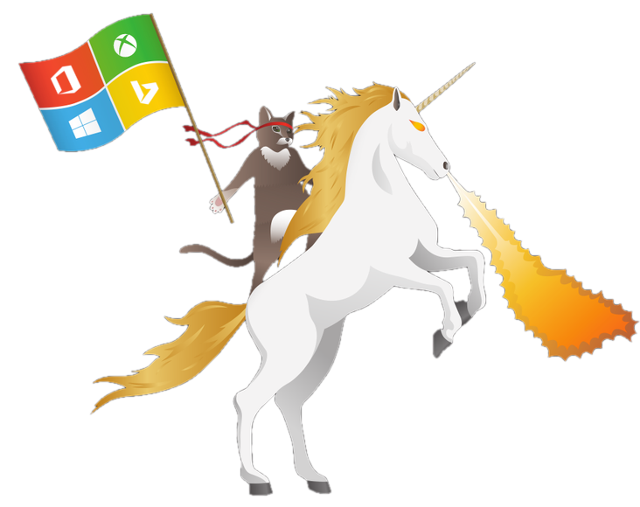

Become a Windows Insider!
https://insider.windows.com/

Slide 4

How far can we get today?
https://www.youtube.com/watch?v=iWXebEeGwn0
And for a follow up…
https://www.youtube.com/watch?v=R2mC-NUAmMk

Slide 5
the mental action or process of acquiring knowledge and understanding through thought, experience, and the senses
Cognition

Slide 6
Cognitive services are a set of APIs that are designed to democratize artificial intelligence by enabling systems to see, hear, speak, understand and interpret our needs using natural methods of communication.
What these services generally do is bring structured semantic data to human knowledge I/O with a degree of confidence
What are Cognitive Services?

Slide 7
Is it Real?
https://www.microsoft.com/cognitive-services/en-us/applications

Slide 8
The Cognitive Services
Vision | Speech | Language | Knowledge | Search
Computer Vision Content Moderator Emotion Face Video | Bing Speech Custom Speech Service Speaker Recognition | Bing Spell Check Language Understanding Linguistic Analysis Text Analytics Translator WebLM | Academic Entity Linking Knowledge Exploration QnA Maker Recommendations | Bing Autosuggest Bing Image Search Bing News Search Bing Video Search Bing Web Search

Slide 9
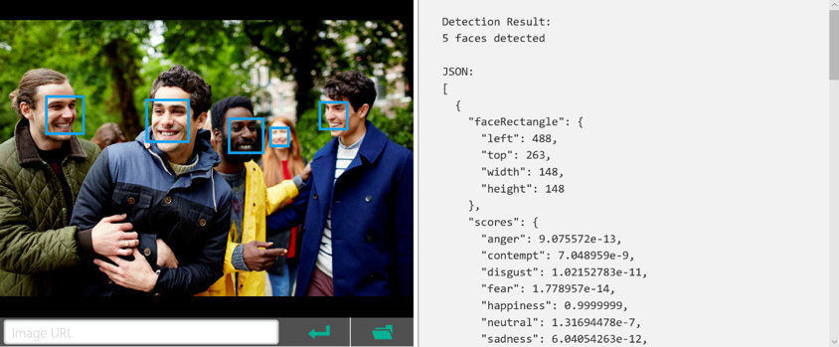
REST/JSON-based
Services

Slide 10
Languages & Runtimes
Any runtime supporting REST calls
Any language that can parse through data
You just need to be able to serialize/deserialize JSON
https://docs.microsoft.com/en-us/azure/cognitive-services/emotion/quickstarts/csharp

Slide 11
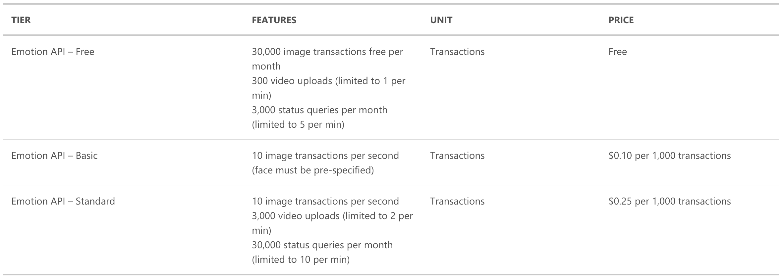
Is this gonna bankrupt me?
https://azure.microsoft.com/en-us/pricing/details/cognitive-services/emotion-api/

Slide 12
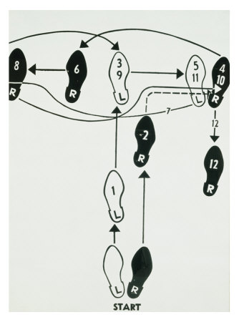
Basic Steps
Get an Azure account
Checkout the online playground
Get Visual Studio if you want to use C#
Grab your keys
Robot Overlord is born!

Slide 13
Stop! Demo Time!

Slide 14
Links
Emotion API Playground: https://azure.microsoft.com/en-us/services/cognitive-services/emotion/
Samples: https://github.com/Microsoft/Cognitive-emotion-windows
GoPiGo: https://www.dexterindustries.com/shop/gopigo3-robot-base-kit/

